Slide 1




Measuring Human Trust in Artificial Intelligence in High-Stakes Environments
Emanuele Bossi, Data Science and Software Engineering
Francesco Busini, Mechanical Engineering
Hadi Ali, Assistant Professor of Aerospace Engineering

Slide 2
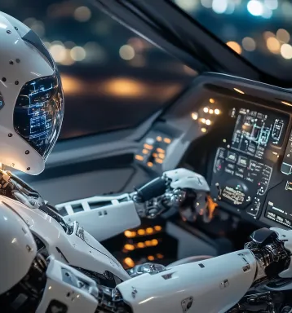

Objective
Primary Goal
    Measure how aviation professionals trust AI-based decision-making in safety-critical scenarios.
Research Focus
    Analyze human-AI interaction during simulated emergency situations.
Key Factors to Explore
    AI transparency
    AI control mechanisms
    Impact of potential confounding factors
End Goal
    Estimation state algorithm
Notes:
EB

Slide 3
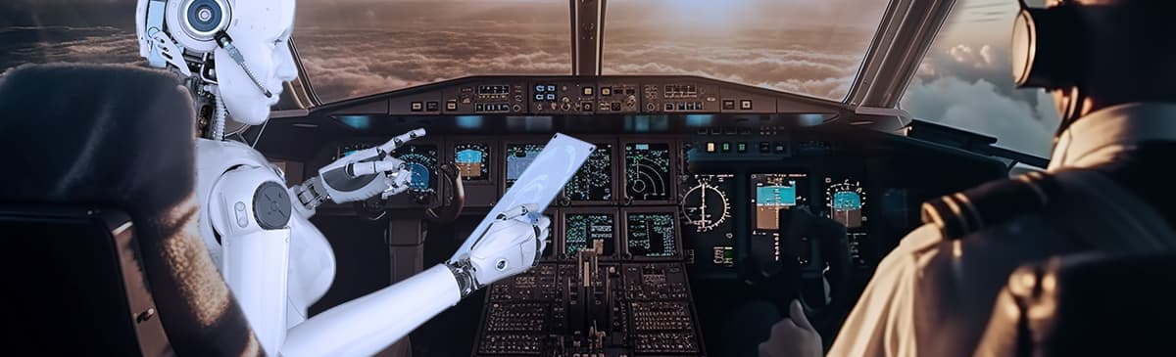
Background
AI algorithms are becoming increasingly prevalent across various industries.
There is a growing need to focus AI development in high-stakes environments due to unique challenges:
  Time Pressure
  Specialized Expertise
  Unique Communication Demands
Trust Paradox: Balancing Undertrust vs. Overtrust.
Notes:
EB

Slide 4

Experiment Setup
Simulator:
Microsoft Flight Simulator 2020 (MSFS2020).
Realistic flight simulator.
Available use of AI.
Cloud-based rendering via Azure AI.
Hardware:
Eye-tracking system.
Heart rate sensor.
Galvanic skin sensor.
Keyboard or joystick.
Notes:
FB

Slide 5
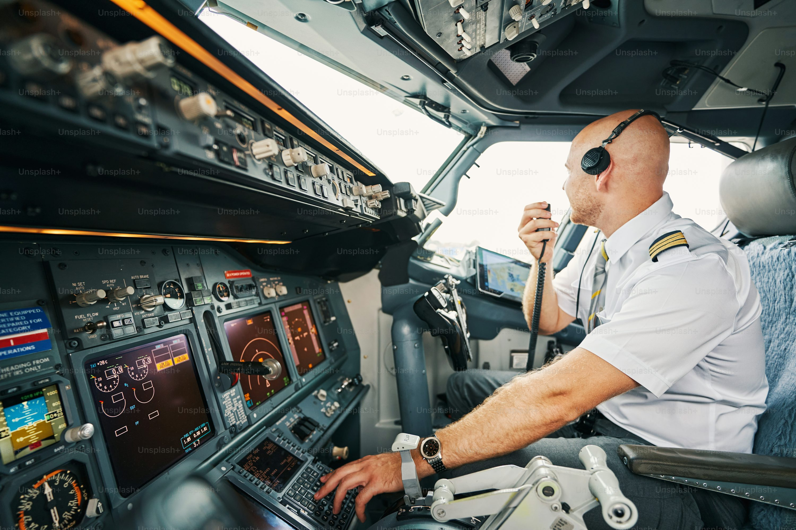
Population
Target population:
- Licensed pilot (private, commercial, or military).
Eligibility criteria:
- Must be 18+ years old.
- Must have aviation-related experience.
- Must provide informed consent.
Notes:
FB

Slide 6

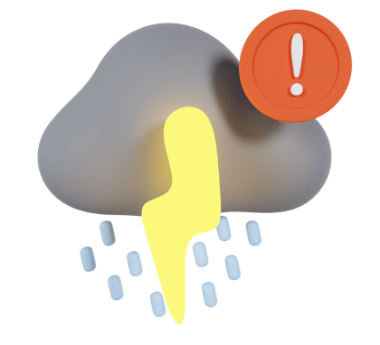
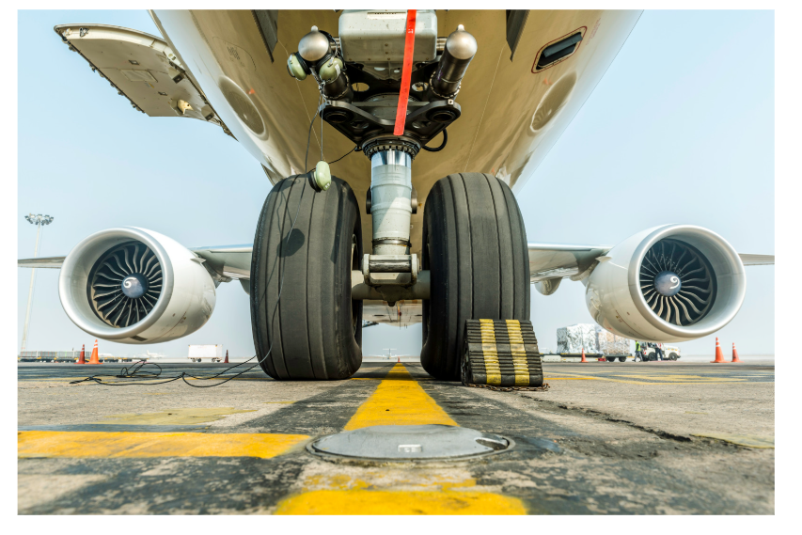
Experiment Scenario
Scenario 1: Engine Failure at Takeoff
Objective: Assess trust in AI for rapid emergency decision-making.
Scenario 2: Mid-Flight Weather Avoidance
Objective: Evaluate trust in AI’s predictive capabilities and situational awareness.
Scenario 3: Landing Gear Malfunction on Final approach
- Objective: Examine trust in AI diagnostics and risk assessment.
Notes:
FB

Slide 7
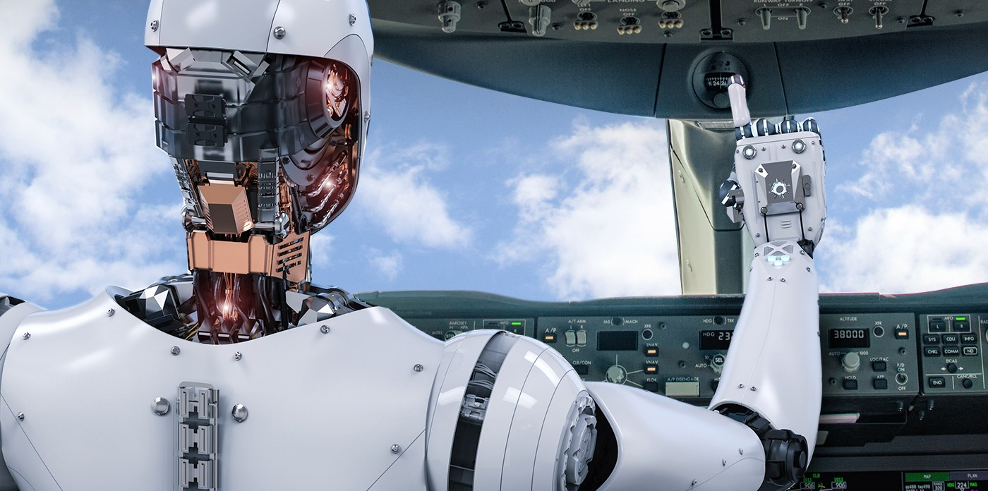


Experimental Conditions
Participants will be assigned one of three AI transparency and control conditions:
  Full AI Automation
  Human Supervision
  Human Decision with AI Monitoring
Notes:
EB

Slide 8
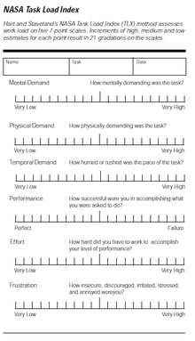
Quantitative Analysis
Workload Measurement
  Cognitive Load
  Task Performance
  Physiological Indicators
Statistical Analysis: To identify statistically significant differences between the study conditions, we will develop a regression algorithm that:
  Analyzes how AI transparency and control influence trust and performance.
  Accounts for potential confounding factors such as prior experience or individual differences (pre and post-experiment surveys).
Notes:
EB

Slide 9

Implications
This study specifically focuses in aviation. However, the experiment’s findings will have implications also in aerospace:
  Ensuring Mission Success and Reliability
  Facilitating Human-AI Collaboration
  Promoting Transparency and Accountability
Notes:
EB

